Slide 1
Simply Map
Make Navigation Easy for Students
Team 30
Arthur Zhang, Dickson Tong, Andrew Yang
Notes:
Greetings!
We are going to present our mapper project that we have poured our heart and soul into for a week.

Slide 2


Purpose, Procedure, and Predicament
Simple general-purpose navigation (especially for students)
Usable (efficiency, learnability, error rate, and satisfaction)
Quick response to user input
Features
Minimalistic User Interface (UI)
Levels of detail management
Accessible points of interest
Relaxing colour design
Notes:
Introduction: (30-45s)
Identify our design focus for students (as well as general navigation)
identify usability and responsiveness as priorities of our design
name the features that we will cover and explain.
admit that our program is not perfect due to inexperience and time constraint and management issues.
Our mapper is designed with focus on simplicity, while being usable and responsive at the same time. The targeted use case is student navigation, but the map is also applicable for general purposes. To achieve this, we have designed features that include but is not limited to :
a minimalistic yet intuitive user interface,
a way to manage the level of detail while zooming that makes the map comprehensible and not cluttered
easily accessible display of points of interests that are discernable by type:
a good looking overall color scheme

Slide 3
GUI Layout
Notes:
I’ll first talk about our UI layout.

Slide 4
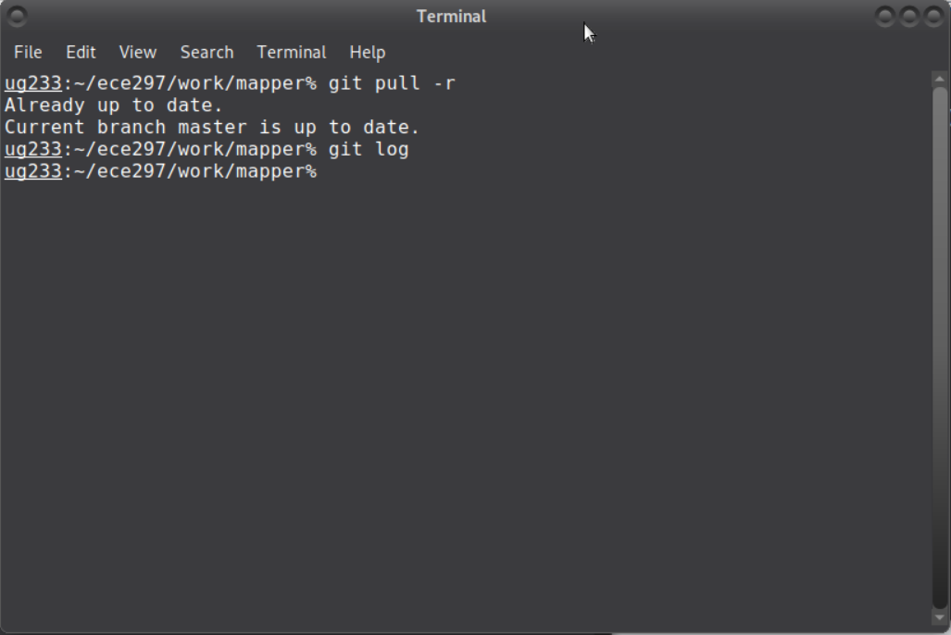
Command Line?
NO!
Notes:
I have a question for you: do you like command line in linux? I believe that no one likes it. You have to remember commands such as cd or ls, and it is too difficult for general users to remember them and use them.
Therefore, we choose to abandon the command line and only use graphic interface. We also choose to make our graphic interface simple so that it could be usable for all students.

Slide 5
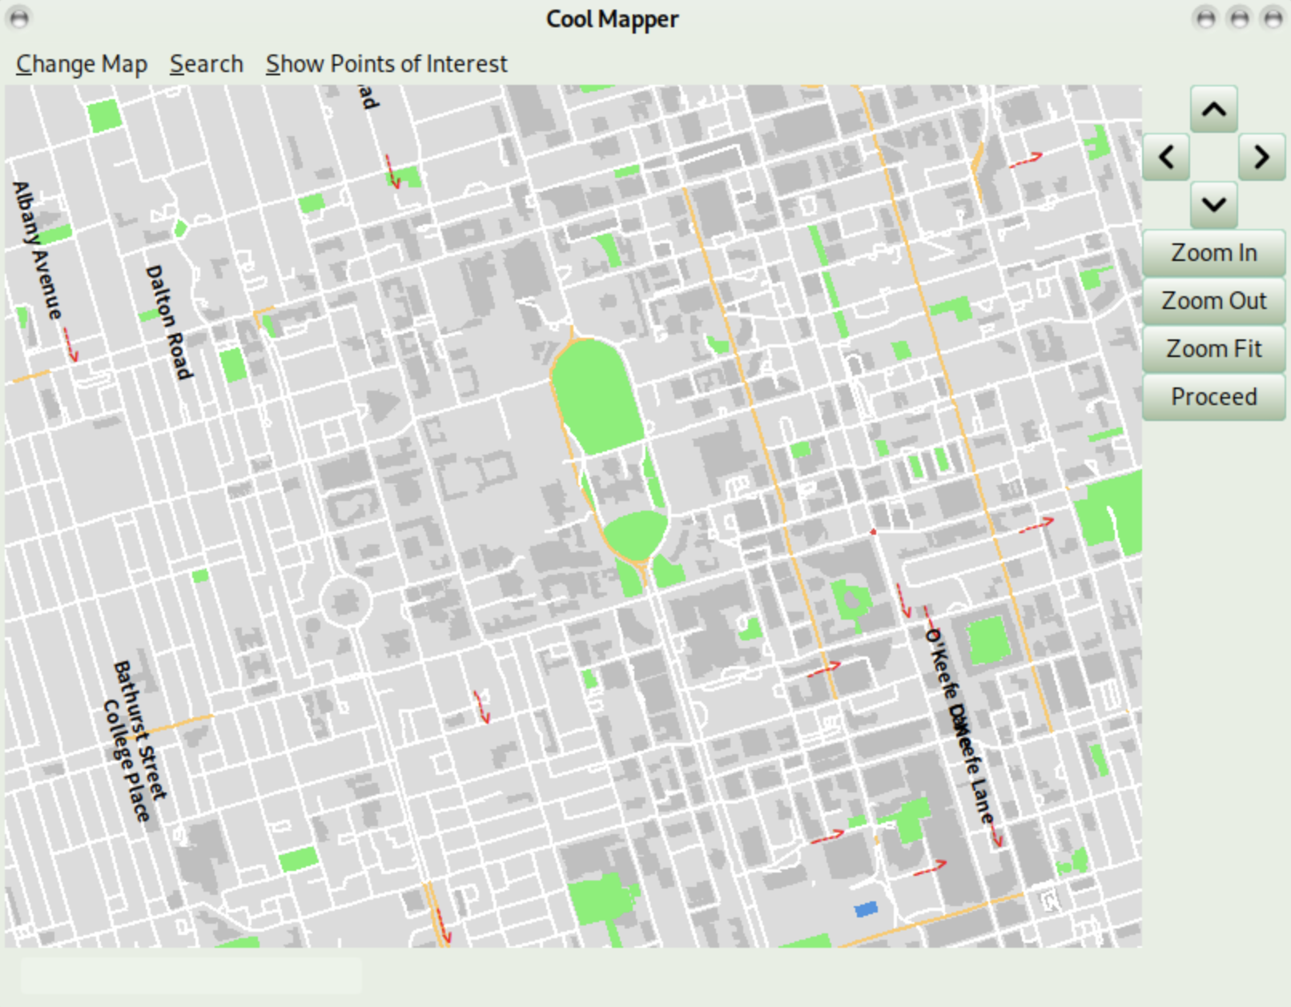
Simple GUI Layout
Maximized area of map and minimized area of buttons
Efficient browsing[1]
Function buttons in the menu bar
Notes:
Our UI layout is simple. The area of map is maximized, while the area of buttons is minimized. Because of that, you can browse the map efficiently and freely without the distraction from toolbars and buttons. Where can I find all function buttons? They are at the menu bar. If you want to use functions such as view school buildings nearby and change the map to other cities, you can simply find all them in the menu bar.

Slide 6
Key Functions

Slide 7
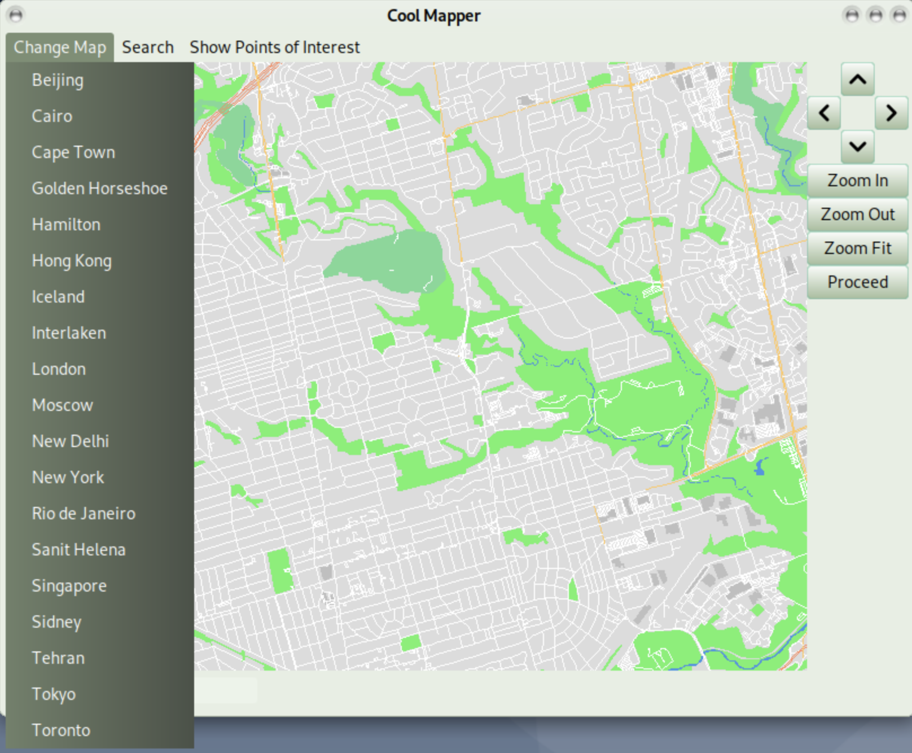
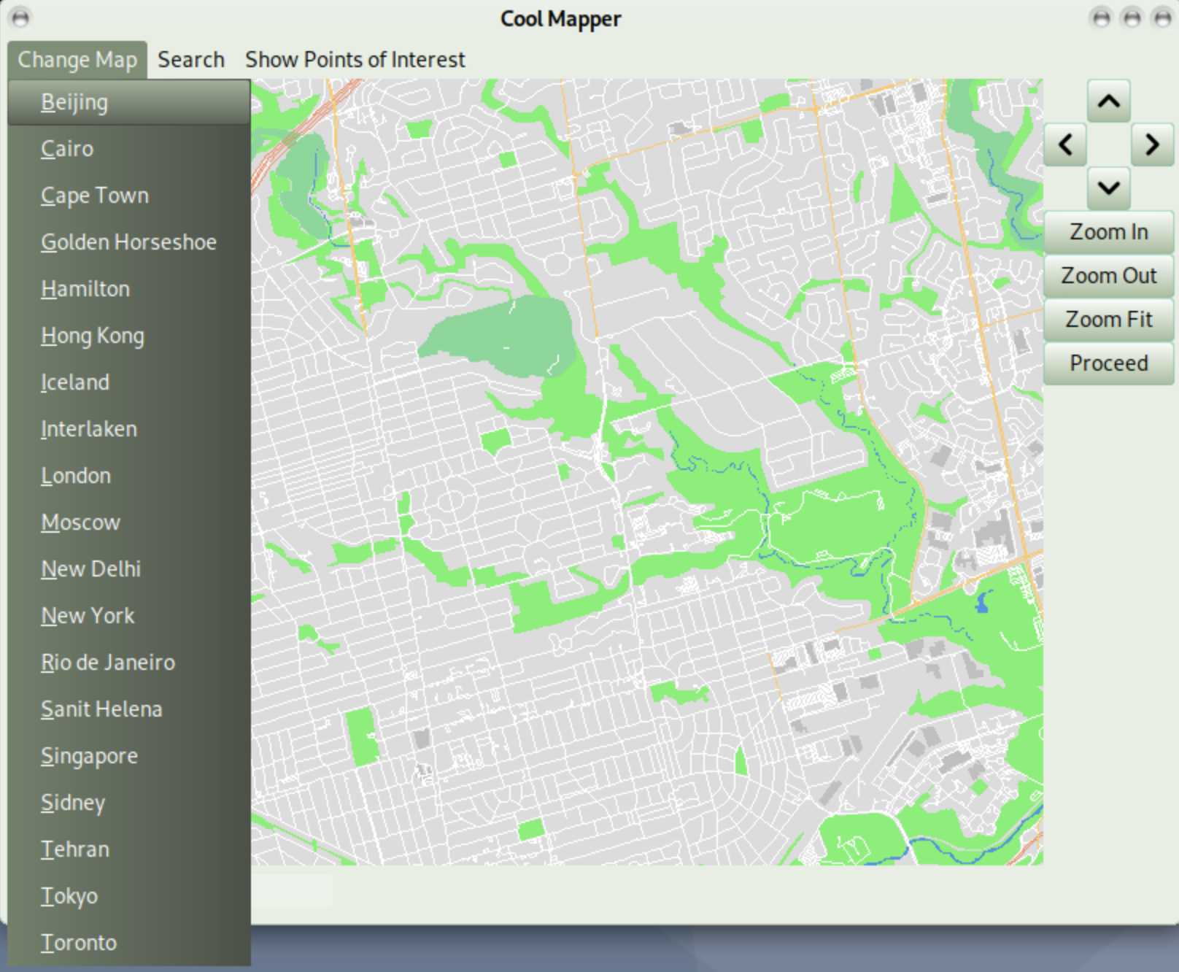
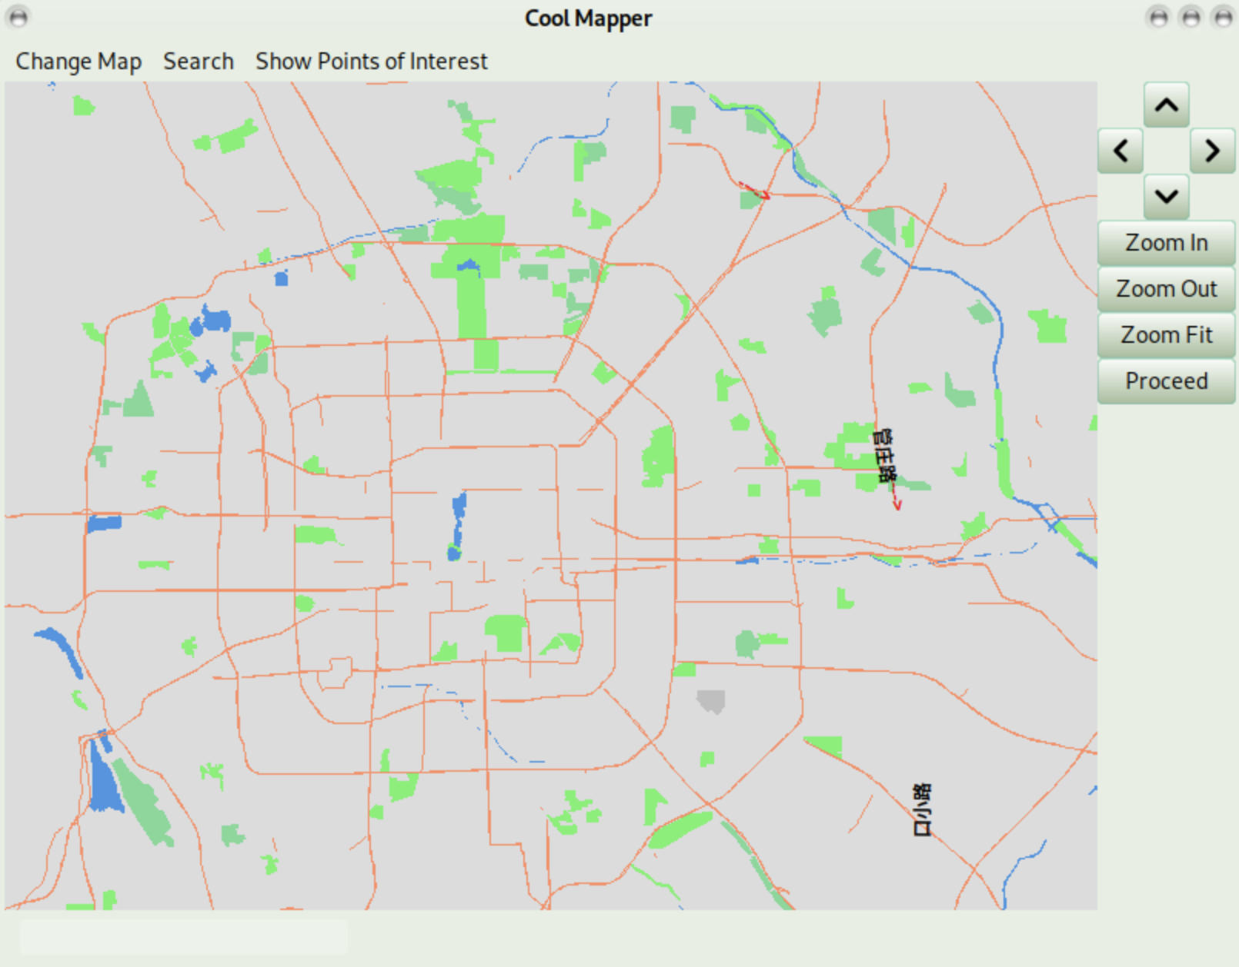
Simply Switch Map
Switch map easily between 19 different cities!
No need to close APP
Notes:
You can simply switch map between 19 different cities without closing the whole application. If you want to see the map of Beijing, you can click on Change Map, and then click on Beijing. After loading all data, the whole map of Beijing will be directly presented to you in the current window.

Slide 8
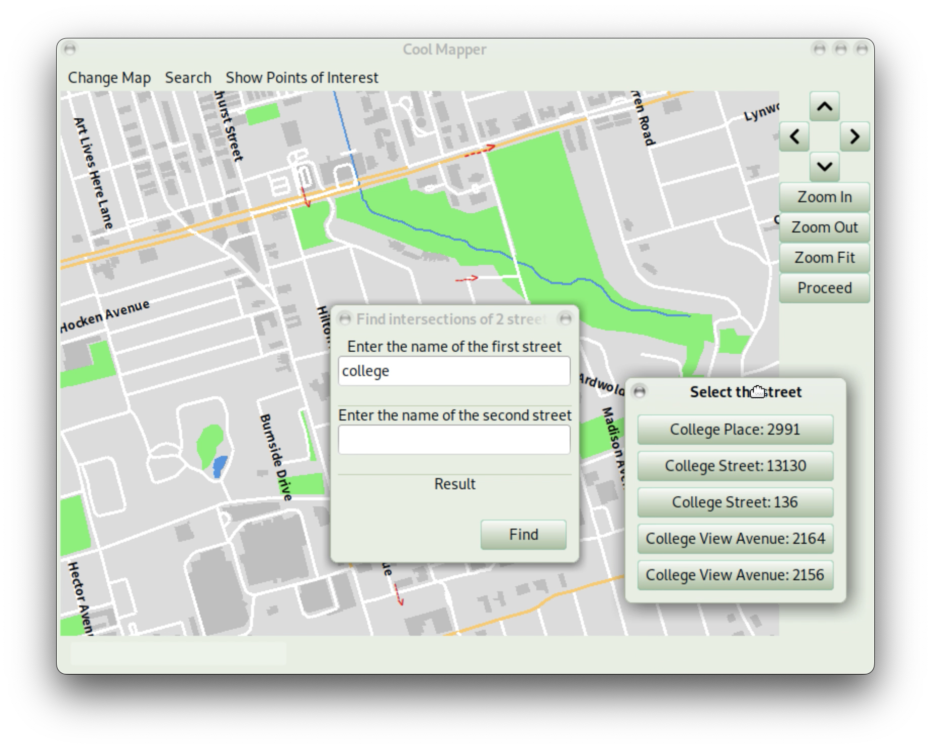
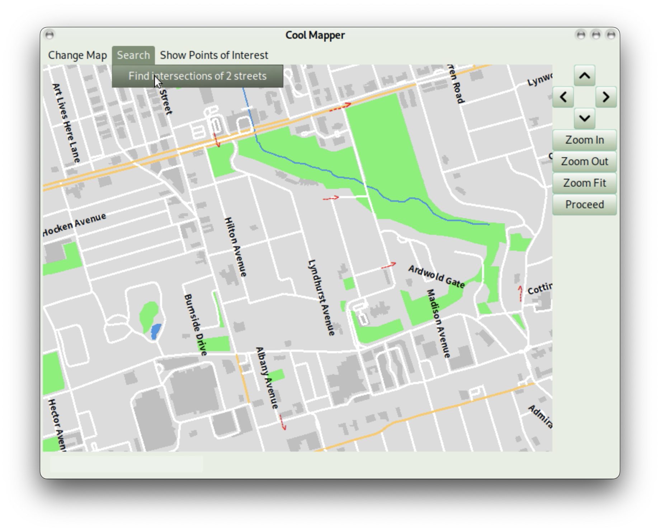
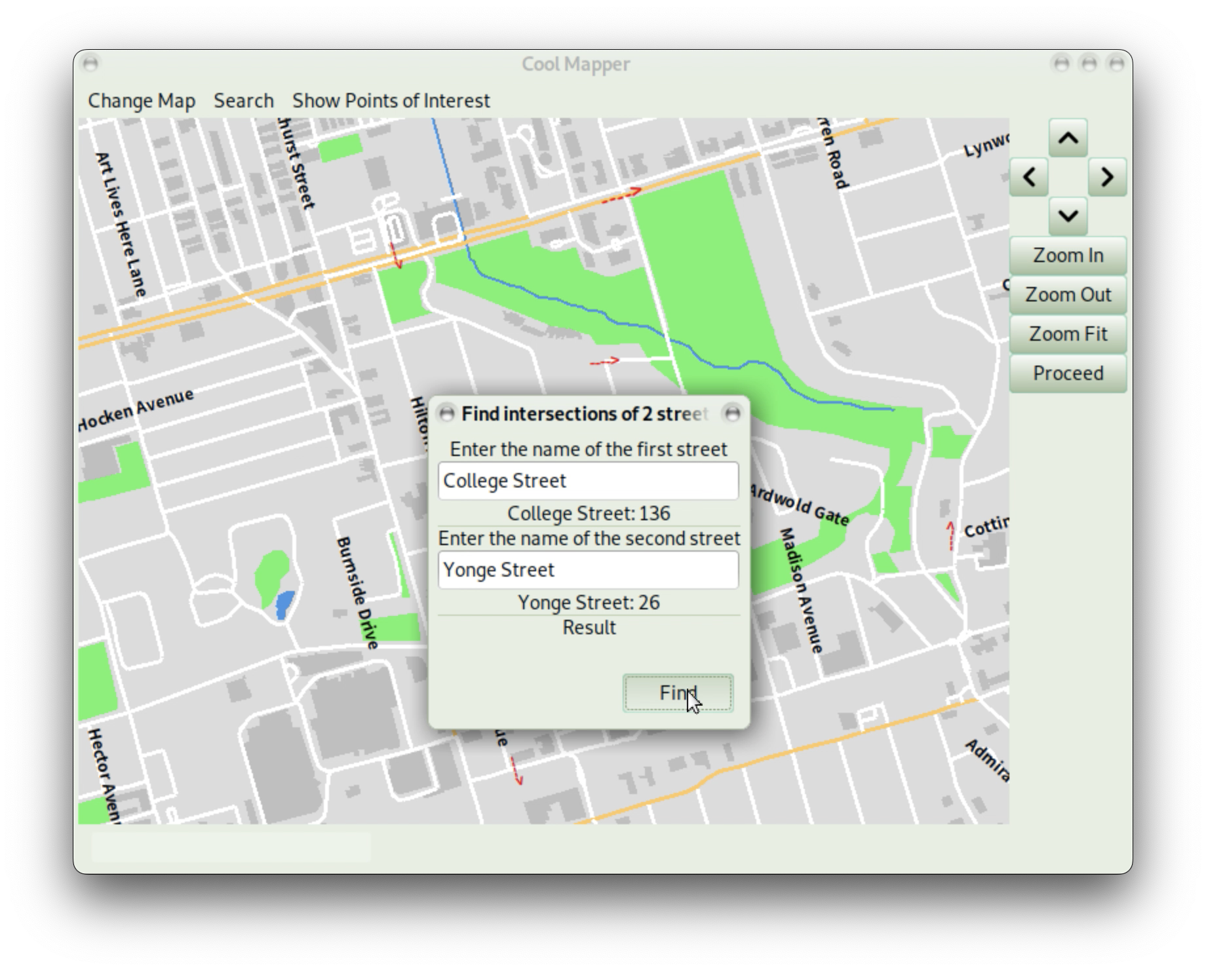
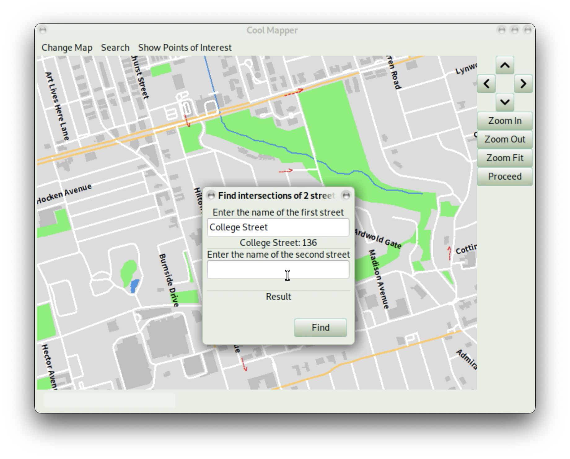

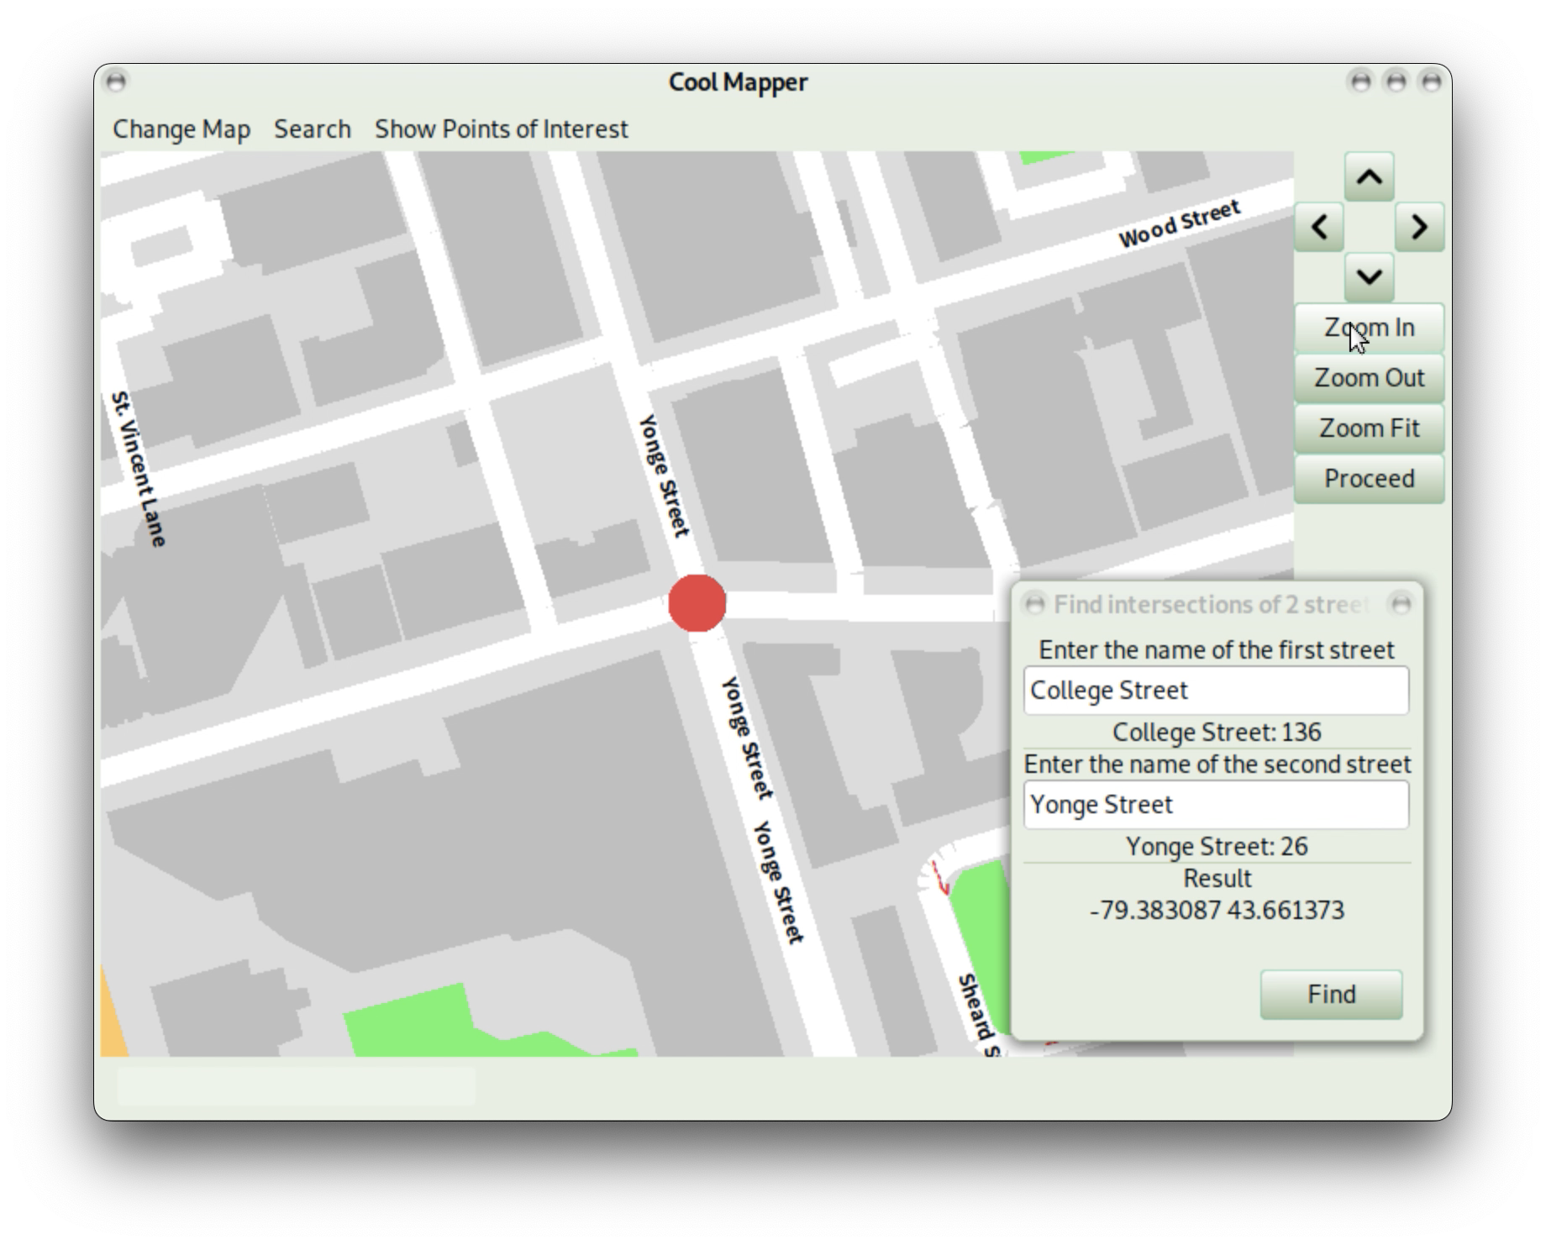
Simply Search
Find common intersections of 2 streets
Notes:
You can also find common intersections of 2 streets intuitively. By clicking search in the menu bar and then find intersections of 2 streets, you can see a pop up dialog. Enter the name of the first street. After pressing enter key, another popup dialog will appear and show suggested street names. Select the name you want. After you entered the name of click on Find to find common intersections of 2 streets. The results will be shown in the dialog, and common intersections will also be highlighted. One intersection will be shown in the center of map so that users can find the position more conveniently in the map.

Slide 9
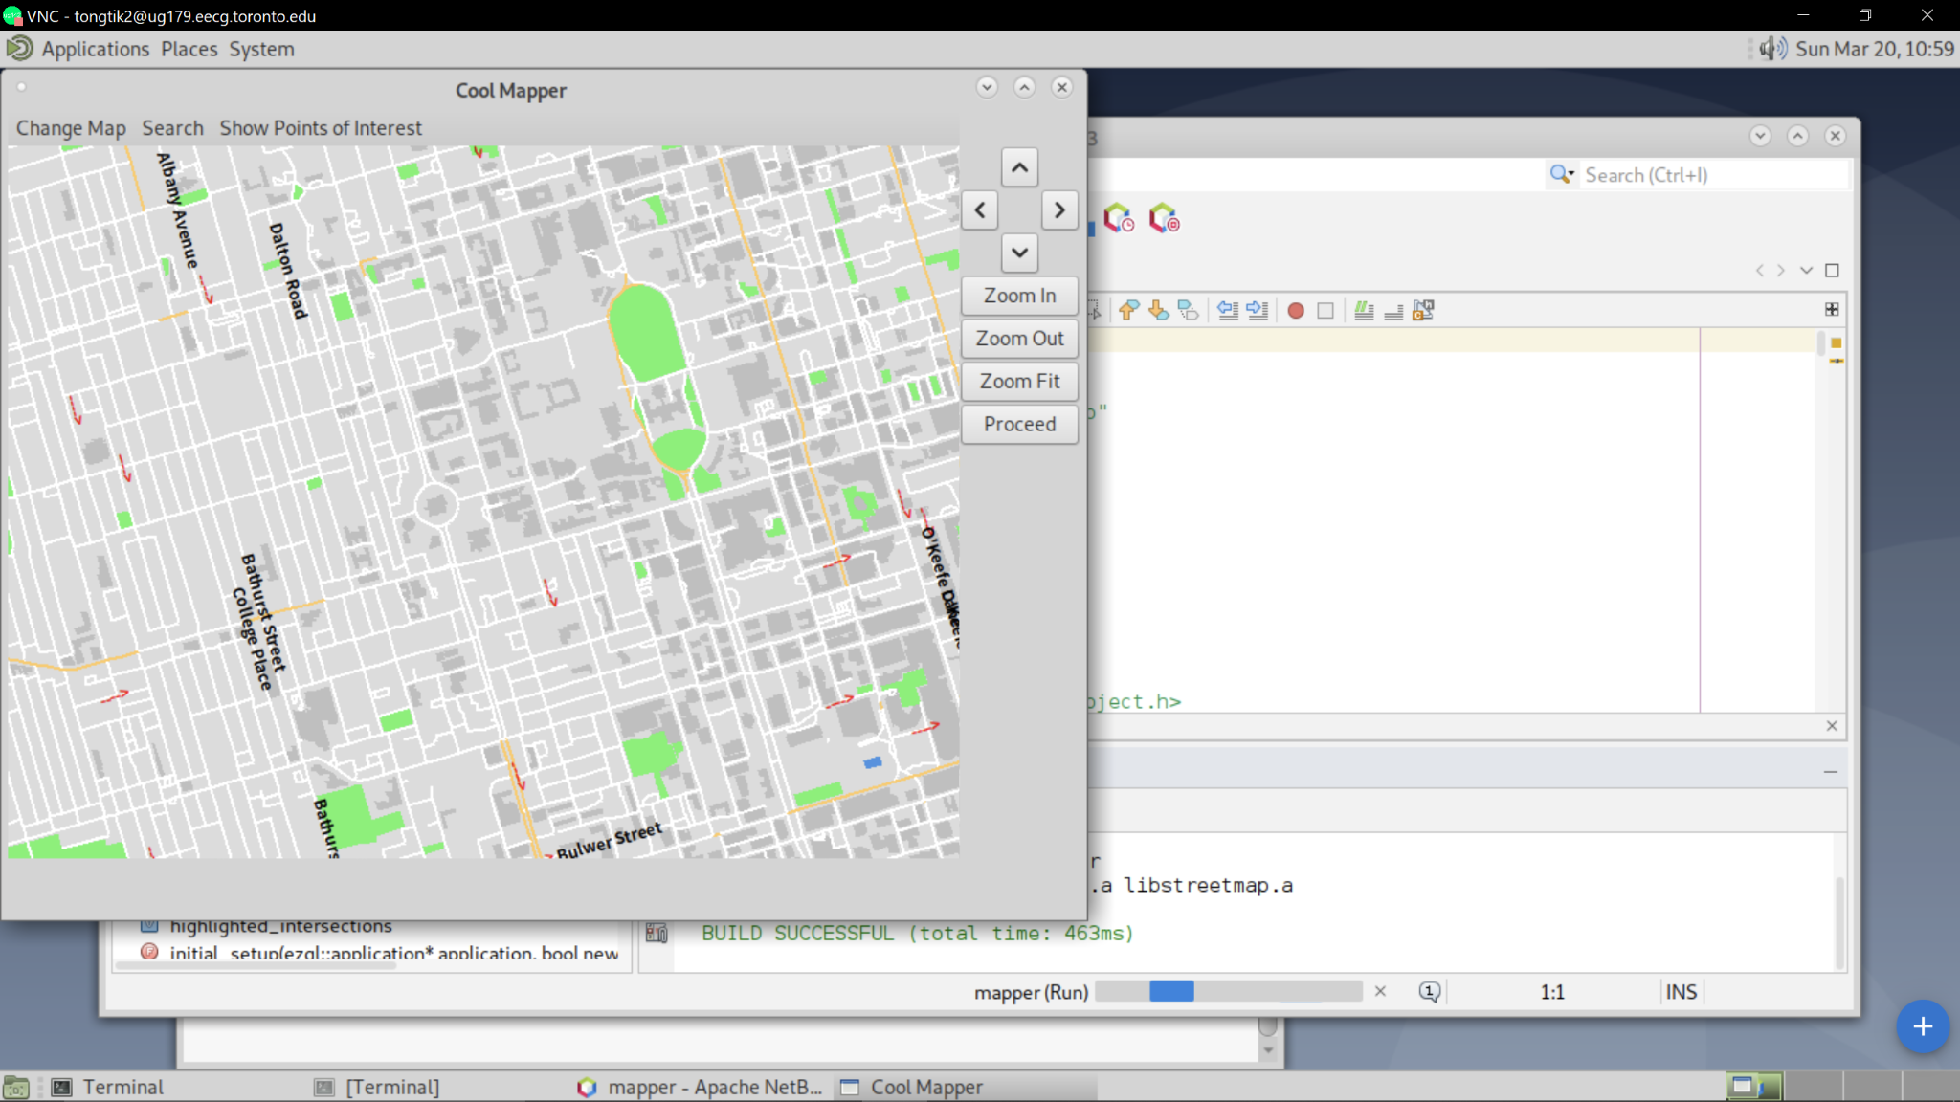
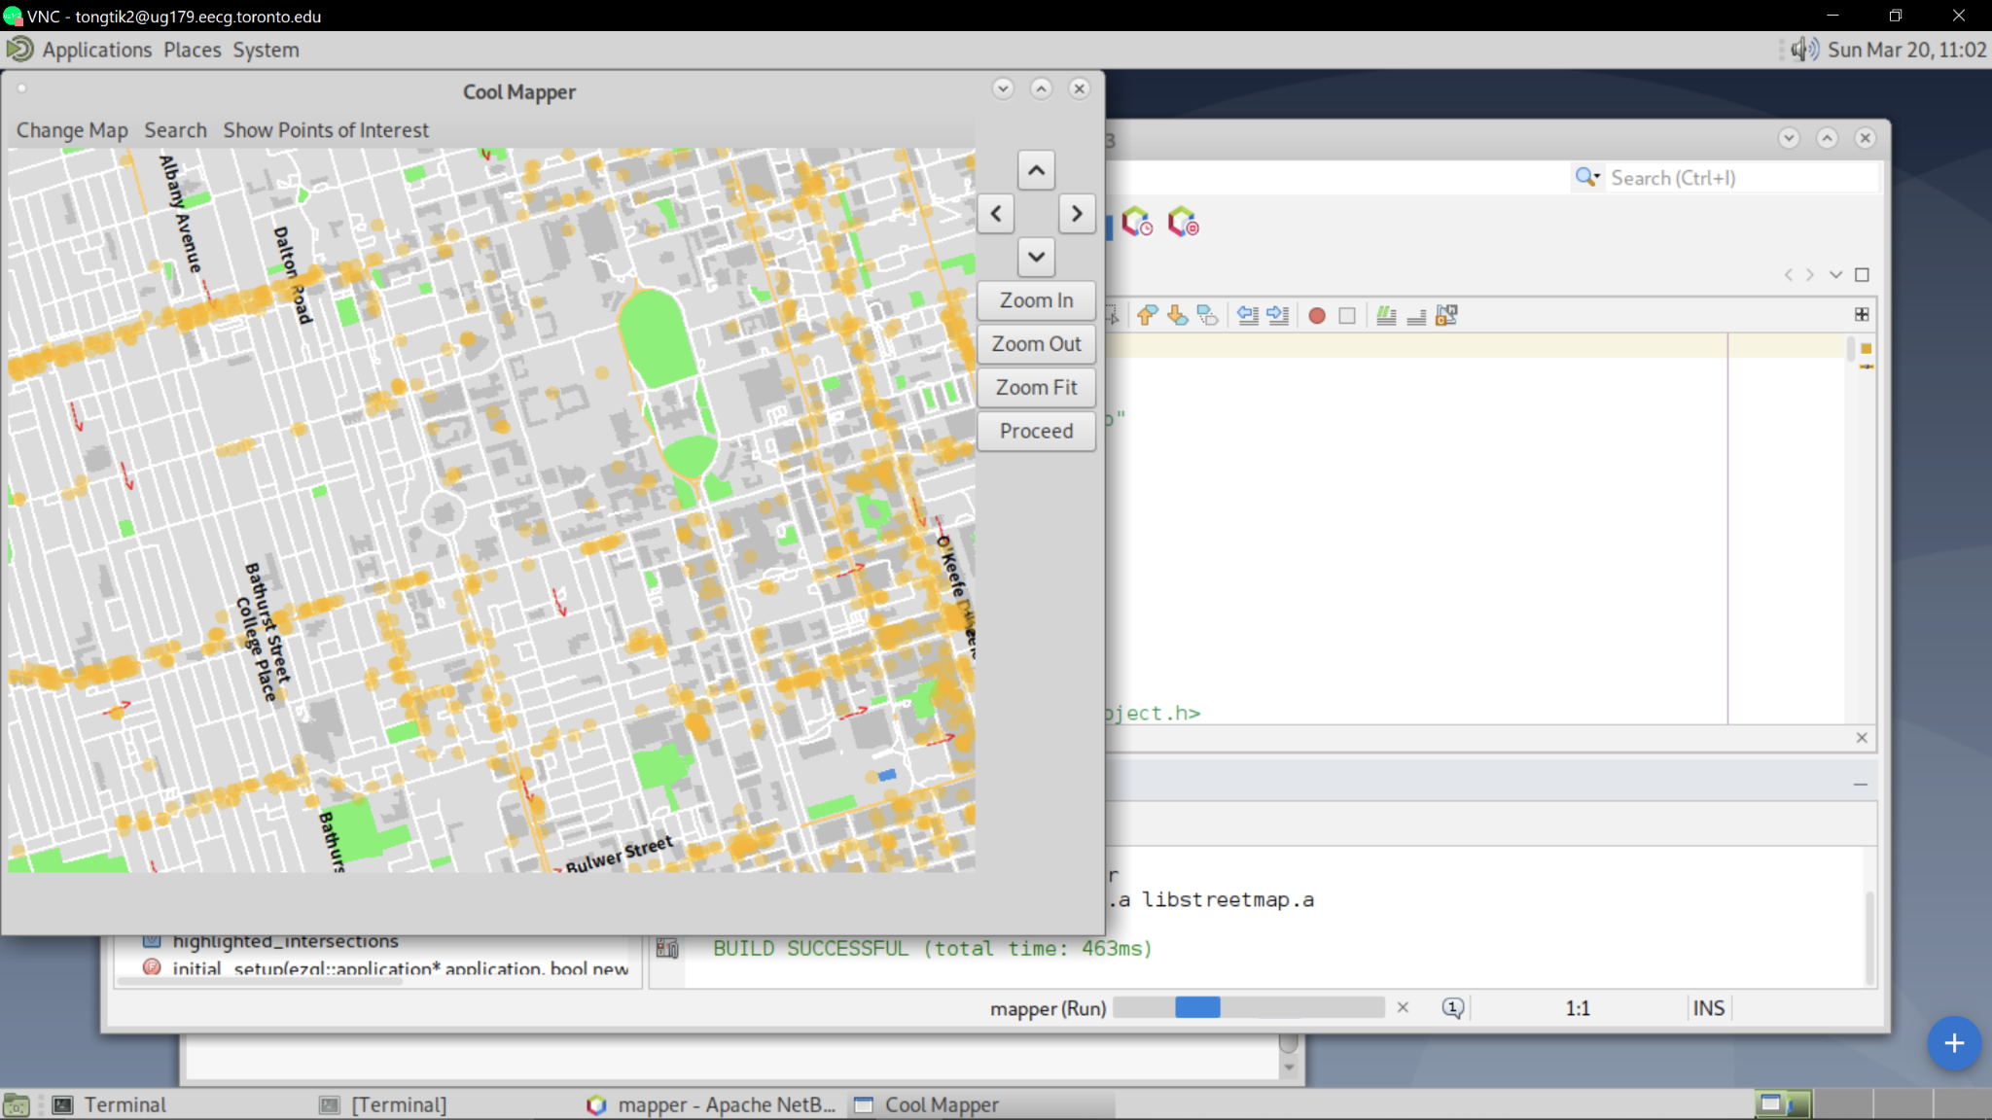

Simply Find Points of Interest
Simply Click
Distribution of POI
Notes:
Want to find some restaurants to go after school, but don’t know where to go. We got you cover. One simple click. You can have access to the distribution of all restaurants, cafes and all other POIs.

Slide 10
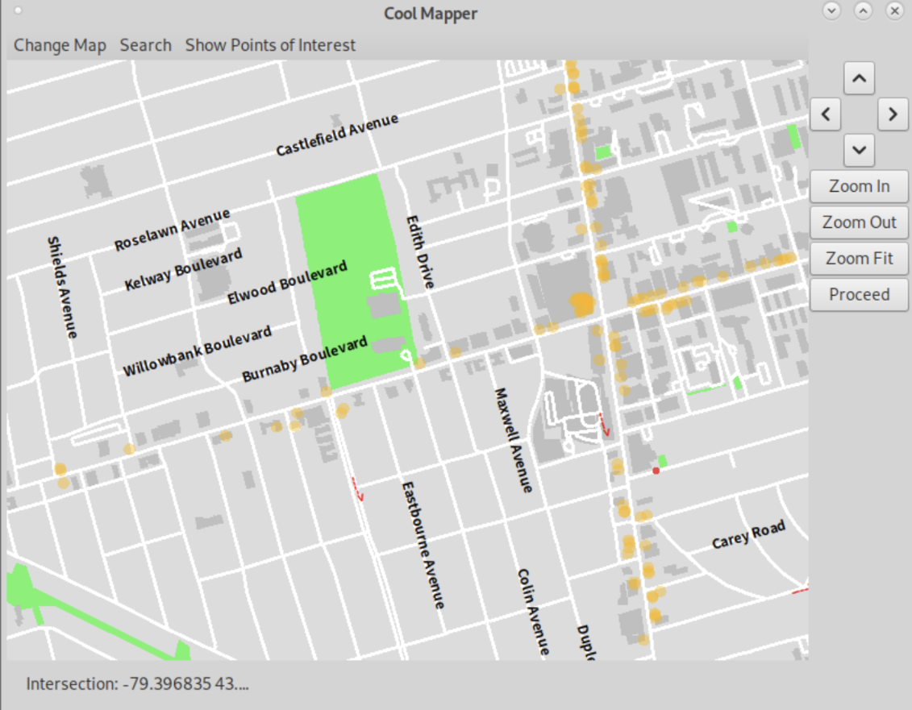
Simply What You Need (Zoom In & Levels of Details)
No
Overcrowded Symbols
Improve
Responsiveness[2]
Notes:
You may ask, why we don’t put the name and icons of the restaurant on the map directly? That’s because we don’t want to make the symbols overcrowded, meanwhile, reduce the amount of drawings can improve the responsiveness of the map.

Slide 11
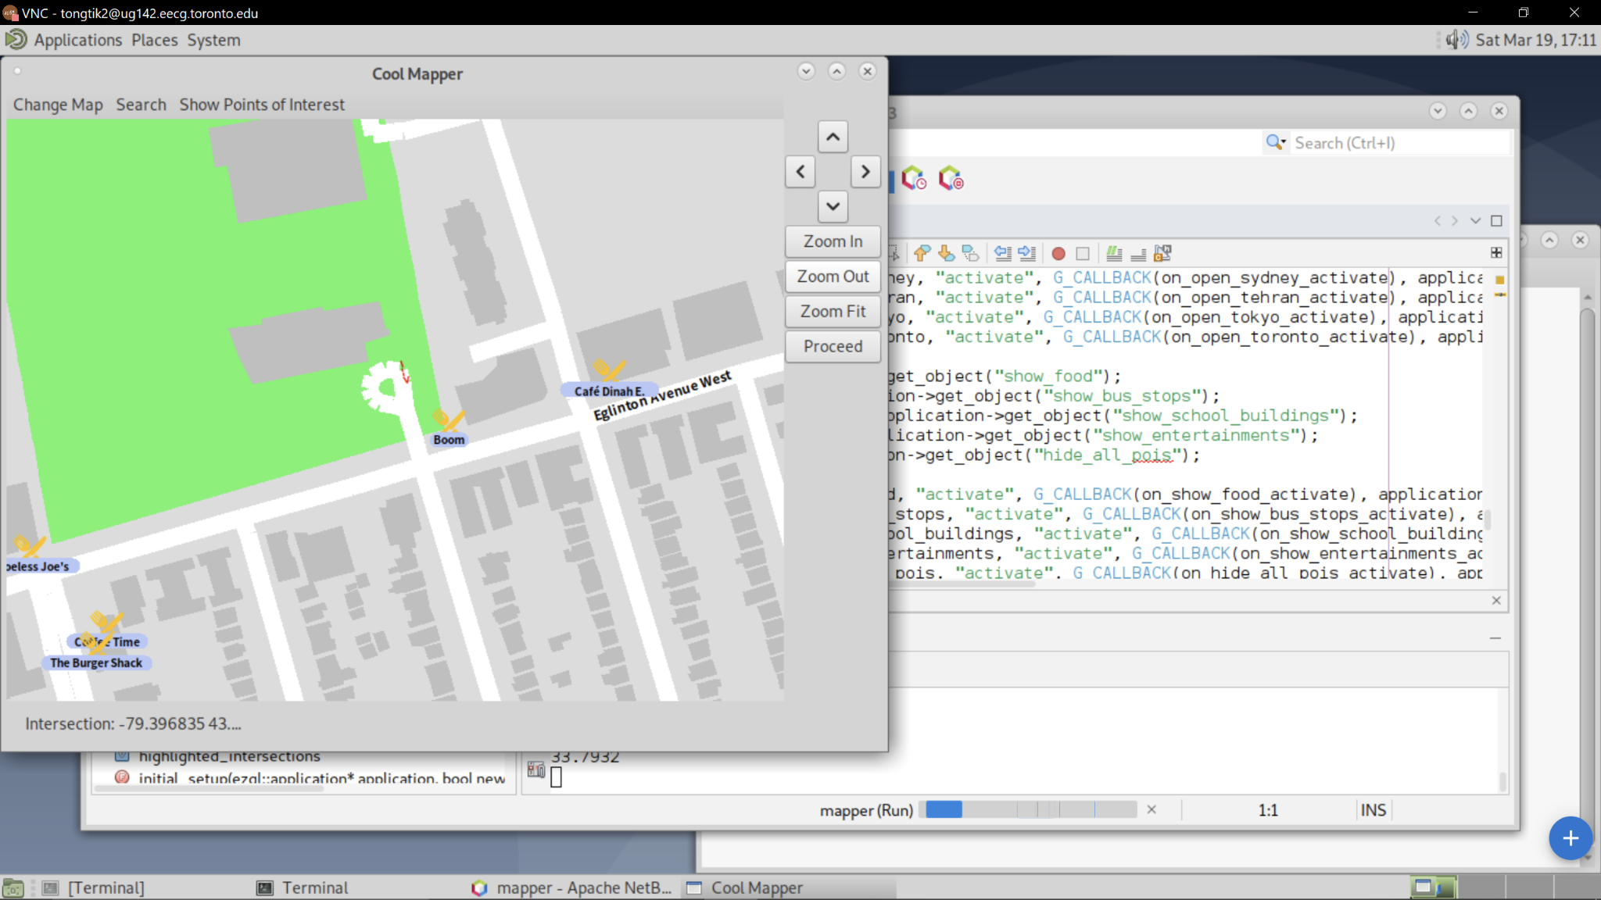
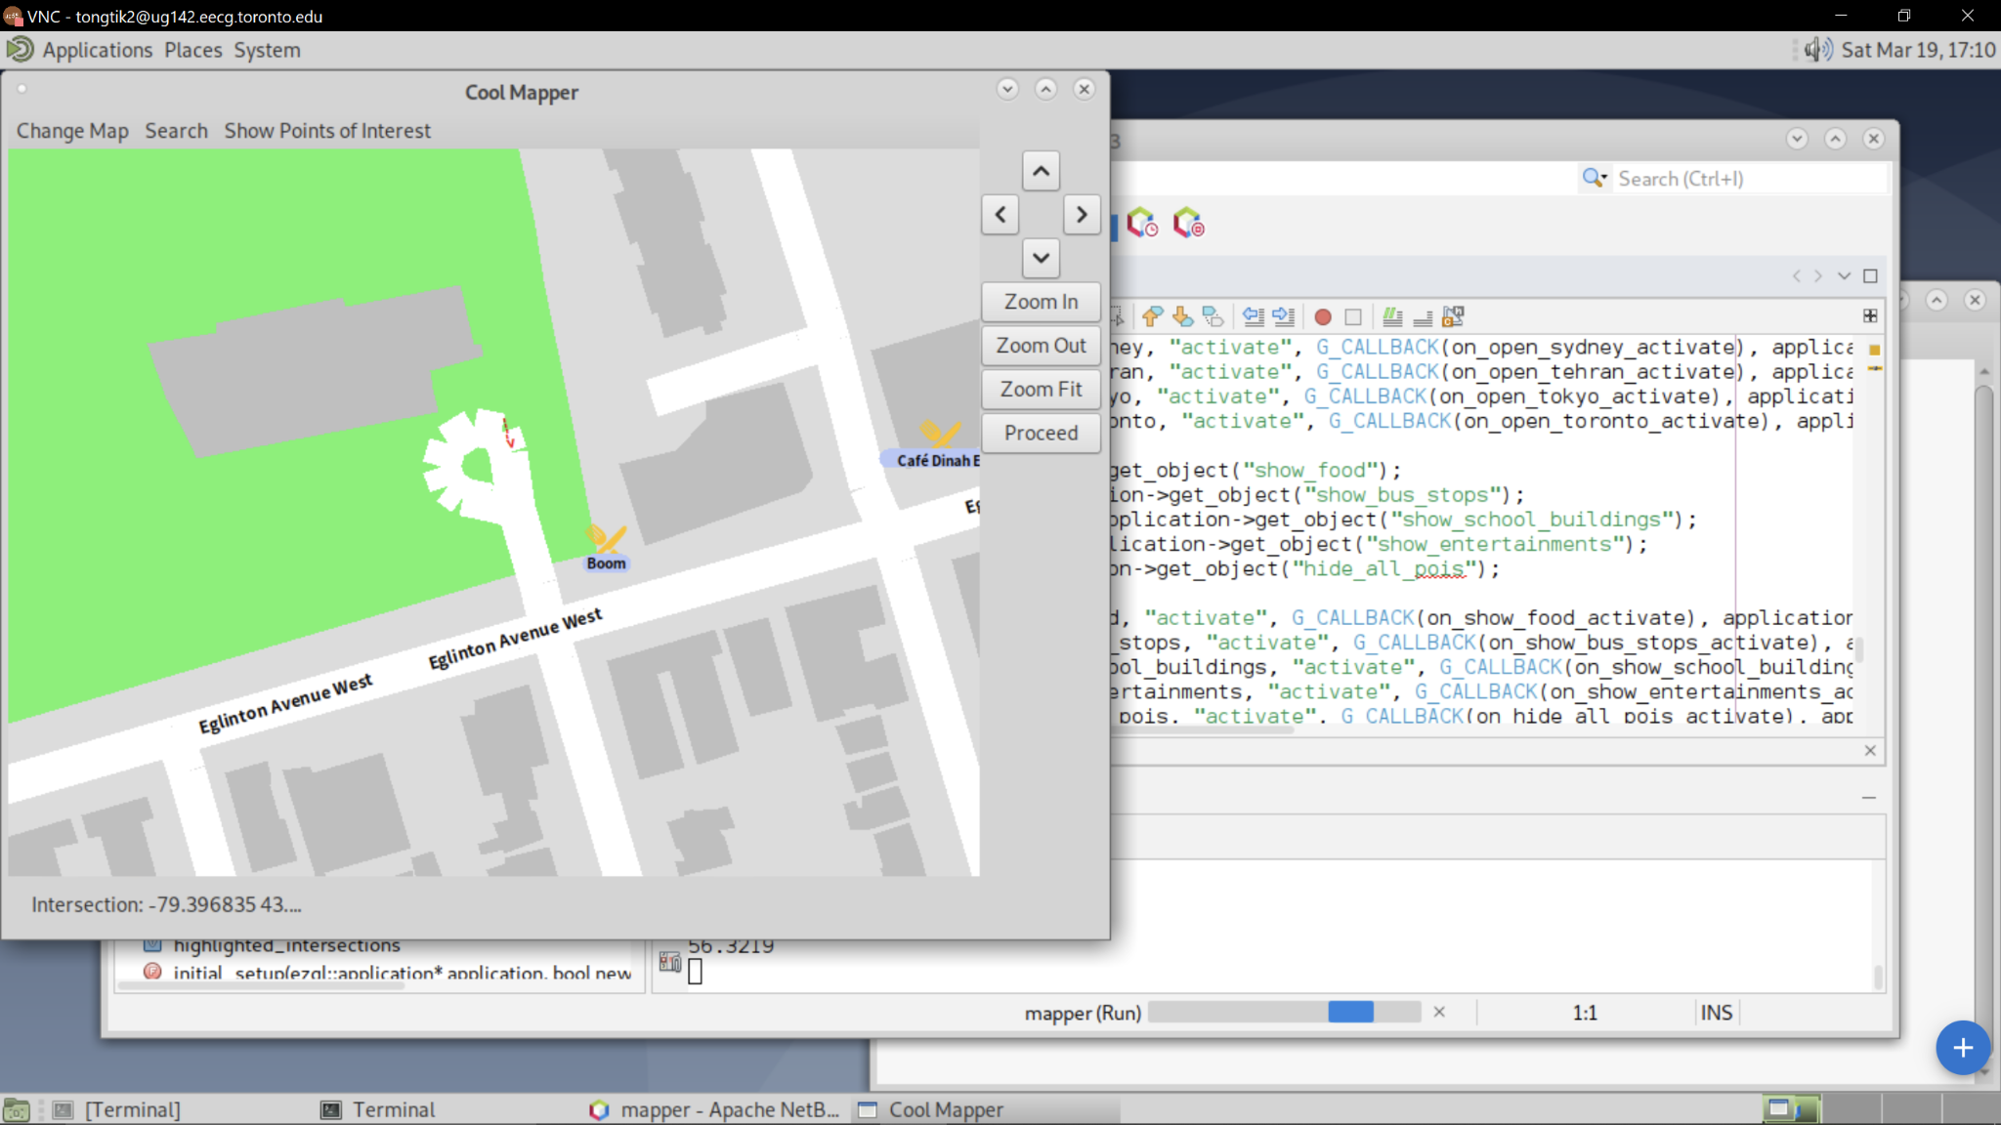
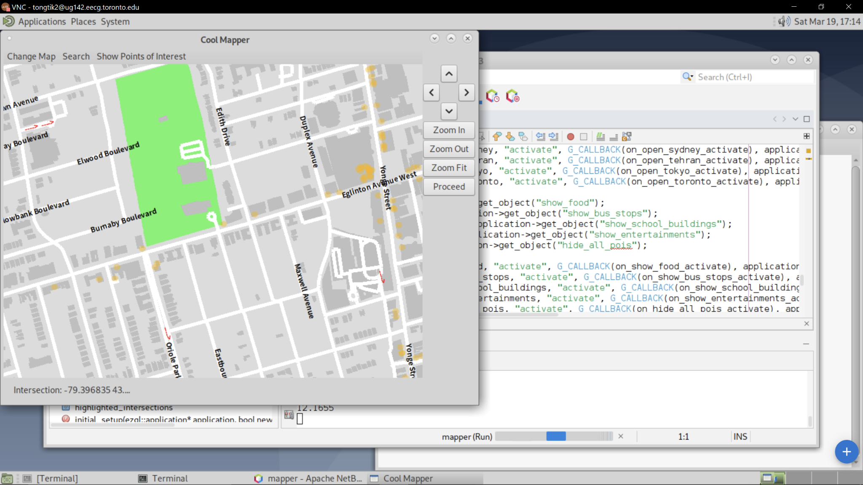
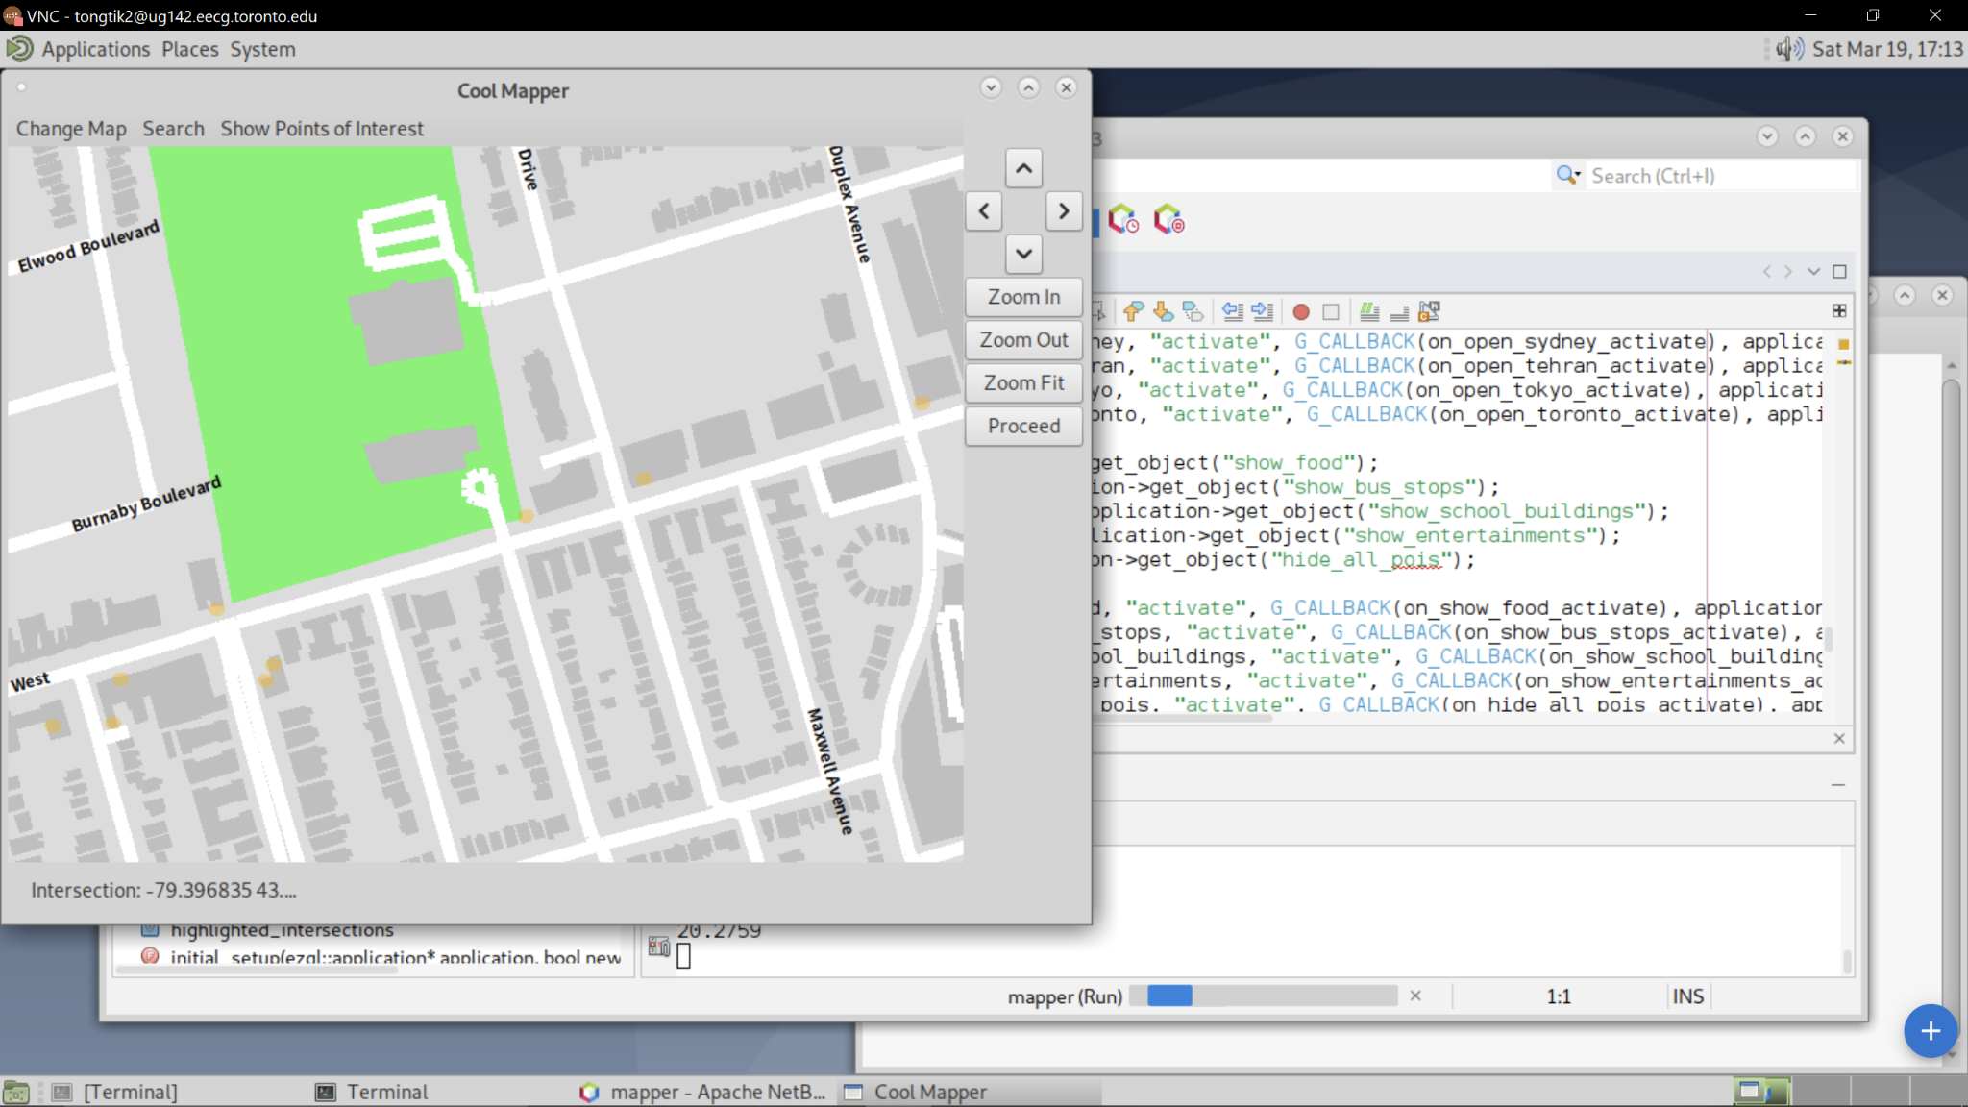
Simply what you need (Zoom In & Levels of Details)
?
“BOOM”
Want to see more details ?
Simply Zoom In
Notes:
But what if you want to know the name of that restaurant? It’s actually quite simple, simply zoom in to get all the details you need.

Slide 12
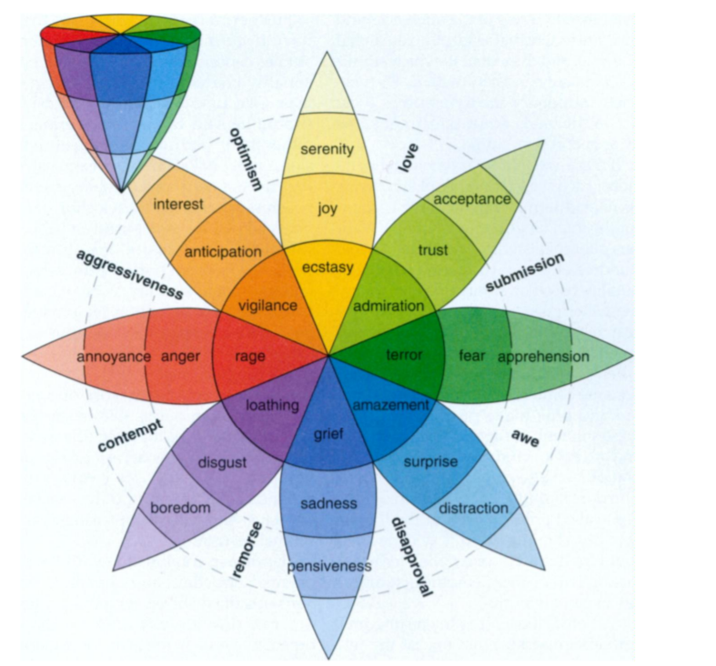
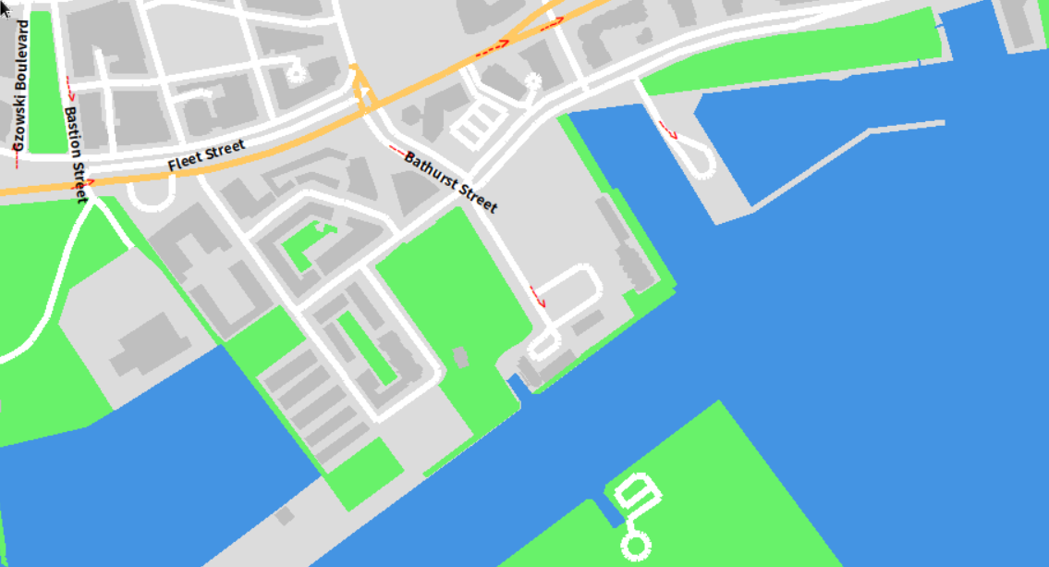
Simply Coloured
Simple colour scheme
Consistent saturation
High contrast to text
Relaxing
Notes:
(60s)
The color of our map is too designed to maximize usability.
First, we minimize the color variety too keep our map simple looking. we only use blue for water, green for grassy areas, yellow for beaches, and orange for main roads. this makes the map more usable by comforming to user expectation, and avoid the distraction that can be caused by too many colors.
Second, we use colors with similar saturation to maintain consistency and harmony
Third, we avoid using darker colors, so black texts are always clearly visible.
Finally, by researching the relationship between colors and emotions, we decided to avoid using colors that is related to negativity, including purple, red, dark blue, and dark green when possible. This make our map relaxing to look at, and satisfactory to use.

Slide 13
Future Plans
Search for points of interest
Show subway stations
Find the shortest path between two points
Salesman’s problem
Notes:
(30s)
Due to the lack of time, some features we have pushed to the future is the search function of points of interest,
showing subway stations,
along with milestone 3 and 4.
…and we will conclude our presentation with a video summary of our program.

Slide 14


Slide 15
Bibliography
colour:
https://uxplanet.org/7-tips-to-organize-colors-for-ui-design-97bbefed8a8a
[1] M. Haklay and A. Zafiri, “Usability engineering for gis: Learning from a screen- shot,” The Cartographic Journal, vol. 45, no. 2, pp. 87–97, 2008. doi: 10.1179/ 174327708X305085. eprint: https://doi.org/10.1179/174327708X305085. [Online]. Available: https://doi.org/10.1179/174327708X305085.
[2] S. Cabello, H. Haverkort, M. van Kreveld, and B. Speckmann, “Algorithmic aspects of proportional symbol maps,” Algorithmica, vol. 58, no. 3, pp. 543–565, 2009. doi: 10.1007/s00453-009-9281-8.

